Slide 1
Thread in Java

Slide 2
Thread
A thread is an independent path of execution within a program.
Many threads can run concurrently within a program.
Every thread in Java is created and controlled by the java.lang.Thread class.
A Java program can have many threads, and these threads can run concurrently.

Slide 3
Class Hierarchy
Object
Thread

Slide 4
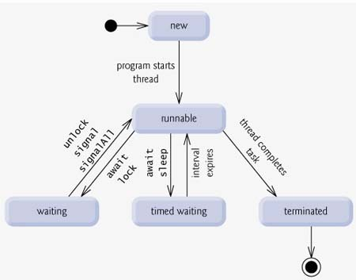
Life Cycle of a Thread

Slide 5
Life Cycle of a Thread
New: A new thread begins its life cycle in the new state. It remains in this state until the program starts the thread. It is also referred to as a born thread.
Runnable: After a newly born thread is started, the thread becomes runnable. A thread in this state is considered to be executing its task.
Waiting: Sometimes a thread transitions to the waiting state while the thread waits for another thread to perform a task.A thread transitions back to the runnable state only when another thread signals the waiting thread to continue executing.
Timed waiting: A runnable thread can enter the timed waiting state for a specified interval of time. A thread in this state transitions back to the runnable state when that time interval expires or when the event it is waiting for occurs.
Terminated: A runnable thread enters the terminated state when it completes its task or otherwise terminates.

Slide 6
Creating a Thread
Java defines two ways in which this can be accomplished:
  You can implement the Runnable interface.
  You can extend the Thread class.

Slide 7
Create Thread by Implementing Runnable
The easiest way to create a thread is to create a class that implements the Runnable interface.
To implement Runnable, a class need only implement a single method called run( ).

Slide 8
Implementing Runnable Interface
import java.lang.*;
public class Counter implements Runnable
{
Thread T;
public void run()
{
....
}
}

Slide 9
Example
class NewThread implements Runnable {
public void run(){
for(int i=1;i<=5;i++){
try{
Thread.sleep(200);
System.out.println("Thread Demo");
}catch(Exception e){}
}
}
public static void main(String args[]) {
Thread t=new Thread(new NewThread());
t.start();
}}

Slide 10
Create Thread by Extending Thread
The second way to create a thread is to create a new class that extends Thread, and then to create an instance of that class.
The extending class must override the run( ) method, which is the entry point for the new thread. It must also call start( ) to begin execution of the new thread.

Slide 11
Extending Thread class
import java.lang.*;
public class Counter extends Thread
{
public void run()
{
....
}
}

Slide 12
Example
class NewThread extends Thread {
public void run(){
for(int i=1;i<=5;i++){
try{
Thread.sleep(200);
System.out.println("Thread Demo");
}catch(Exception e){}
}
}
public static void main(String args[]) {
NewThread t=new NewThread();
t.start();
} }

Slide 13
Thread Class Methods
static Thread currentThread()
String getName()
void setName(String name)
int getPriority()
void setPriority(int newPriority)
boolean isAlive()
static void sleep(long millis)
void join()
void resume()
void run()
void start()
void suspend()

Slide 14
How to get the name of a running thread
public class NewClass extends Thread{
public static void main(String args[]){
System.out.println("Current Thread: "+Thread.currentThread());
System.out.println("Current Thread Name:"+Thread.currentThread().getName());
System.out.println("Current Thread Priority:"+Thread.currentThread().getPriority());
Thread.currentThread().setName("Thread 1");
System.out.println("Current Thread Name:"+Thread.currentThread().getName());
NewClass t1=new NewClass();
System.out.println("My Thread :"+t1);
t1.setName("My Thread");
System.out.println("Name :"+t1.getName());
System.out.println("Priority :"+t1.getPriority());
}}
Current Thread: Thread[main,5,main]
Current Thread Name:main
Current Thread Priority:5
Current Thread Name:Thread 1
My Thread :Thread[Thread-0,5,main]
Name :My Thread
Priority :5

Slide 15
How to check a thread is alive or not?
public class NewClass extends Thread{
public void run(){
System.out.println("Thread Running");
}
public static void main(String args[]){
NewClass t1=new NewClass();
System.out.println("Is Alive :"+t1.isAlive());
t1.start();
System.out.println("Is Alive :"+t1.isAlive());
try{
Thread.sleep(100);
}catch(Exception e){}
System.out.println("Is Alive :"+t1.isAlive());
}}
Is Alive :false
Is Alive :true
Thread Running
Is Alive :false

Slide 16
join()
public class NewClass extends Thread{
public void run(){
for(int i=0;i<5;i++)
System.out.println("Join Demo");
}
public static void main(String argv[]) throws Exception{
NewClass t1=new NewClass();
t1.start();
NewClass t2=new NewClass();
t2.start();
t2.join();
System.out.println("End");
} }
Join Demo
Join Demo
Join Demo
Join Demo
Join Demo
Join Demo
Join Demo
Join Demo
Join Demo
Join Demo
End

Slide 17
Suspending a Thread
public class NewClass extends Thread{
public void run(){
for(int i=0;i<5;i++)
{
System.out.println("Join Demo");
try{Thread.sleep(100);}catch(Exception e){}
} }
public static void main(String argv[]) throws Exception{
NewClass t1=new NewClass();
t1.start();
Thread.sleep(100);
t1.suspend();
System.out.println("End"); } }
Join Demo
End

Slide 18
Resuming a Thread
public class NewClass extends Thread{
public void run(){
for(int i=0;i<5;i++)
{
System.out.println("Join Demo");
try{Thread.sleep(100);}catch(Exception e){}
}
}
public static void main(String argv[]) throws Exception{
NewClass t1=new NewClass();
t1.start();
Thread.sleep(100);
t1.suspend();
Thread.sleep(100);
t1.resume();
System.out.println("End"); } }
Join Demo
End
Join Demo
Join Demo
Join Demo
Join Demo

Slide 19
Display Thread status
public class NewClass extends Thread{
public void run(){
System.out.println("Running.......");
}
public static void main(String argv[]) throws Exception{
NewClass t1=new NewClass();
System.out.println(t1.getState());
t1.start();
System.out.println(t1.getState());
t1.join();
System.out.println(t1.getState());
System.out.println("End");
} }
NEW
RUNNABLE
Running......
TERMINATED
End

Slide 20
Multi-Thread
public class NewClass implements Runnable{
Thread t;
NewClass(String name){
t=new Thread(this,name);
t.start();
}
public void run(){
for(int i=1;i<=5;i++)
{
try{
Thread.sleep(200);
}catch(Exception e){}
System.out.println(t.getName()+" Running....");
}
}
public static void main(String argv[]) {
NewClass t1=new NewClass("Thread 1");
NewClass t2=new NewClass("Thread 2");
NewClass t3=new NewClass("Thread 3");
} }
Thread 1 Running....
Thread 2 Running....
Thread 3 Running....
Thread 3 Running....
Thread 2 Running....
Thread 1 Running....
Thread 3 Running....
Thread 2 Running....
Thread 1 Running....
Thread 3 Running....
Thread 2 Running....
Thread 1 Running....
Thread 3 Running....
Thread 2 Running....
Thread 1 Running....

Slide 21
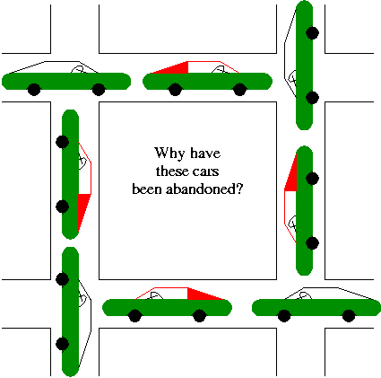
Dead Lock
A deadlock is a situation where in two or more competing actions are each waiting for the other to finish, and thus neither ever does.

Slide 22
Synchronization
When two or more threads need access to a shared resource, they need some way to ensure that the resource will be used by only one thread at a time.
The process by which this synchronization is achieved is called thread synchronization.
The synchronized keyword in Java creates a block of code referred to as a critical section. Every Java object with a critical section of code gets a lock associated with the object. To enter a critical section, a thread needs to obtain the corresponding object's lock.

Slide 23
Example
class NewThread extends Thread {
public synchronized void run(){
for(int i=1;i<=5;i++){
try{
Thread.sleep(200);
System.out.println("Thread Demo");
}catch(Exception e){}
}
}
public static void main(String args[]) {
NewThread t=new NewThread();
t.start();
} }

Slide 24
Java – Inter thread Communication
* wait( ): This method tells the calling thread to give up the monitor and go to sleep until some other thread enters the same monitor and calls notify( ).
* notify( ): This method wakes up the first thread that called wait( ) on the same object.
* notifyAll( ): This method wakes up all the threads that called wait( ) on the same object. The highest priority thread will run first.

